Slide 1
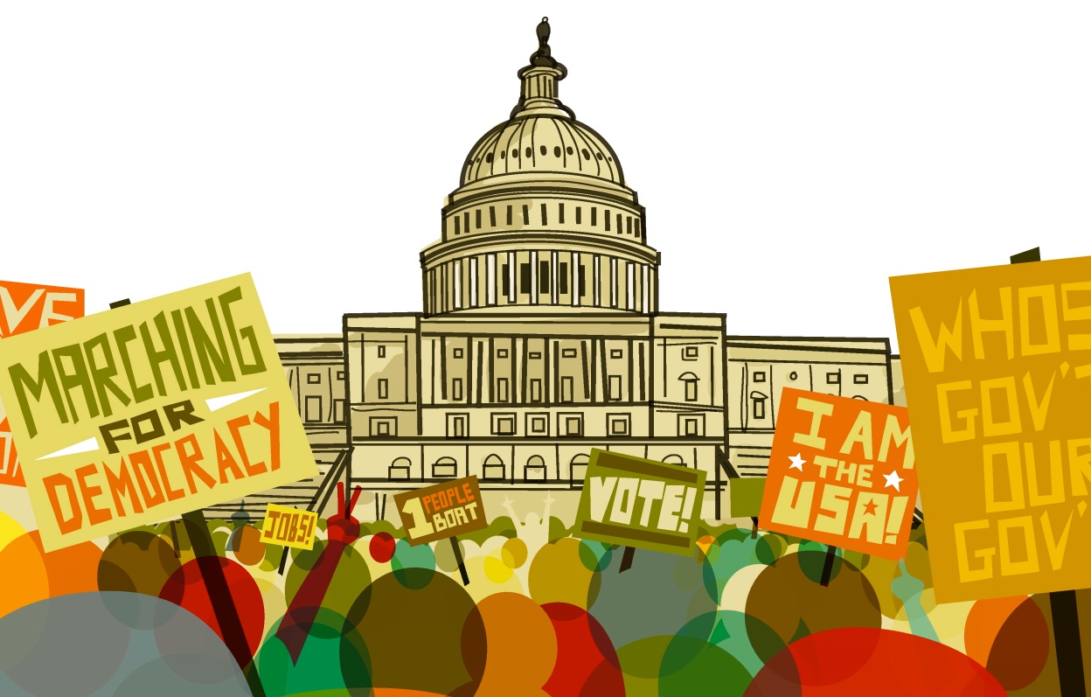
Making Sense of the Federal Budget Eugene, Oregon, March 12, 2016
Peace Action Education Fund National Priorities Project
Supported by the Colombe Foundation

Slide 2
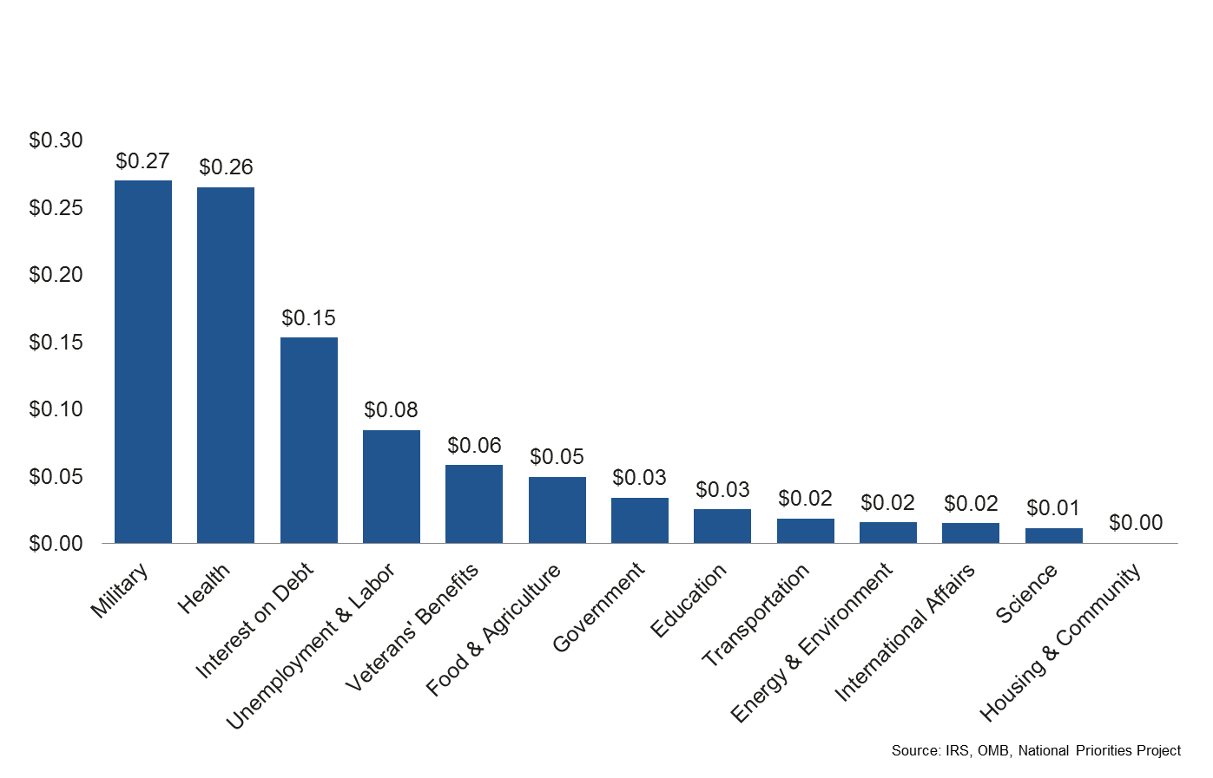
Where did your 2014 federal income tax dollars go?
Notes:
For those of you who didn’t get a chance to participate in the dots exercise, your colleagues here were given 20 dots and told they paid $1.00 in federal income tax this year (each of the dots represents a nickel). They were asked to place their nickels on this chart showing where they would have liked to seen their federal income tax dollars spent this year.
This slide here shows where we actually spent our federal income tax dollars in 2013. See how different this is from where folks in this room placed their dots?
The military spending figures we will discuss today encompass the base Department of Defense budget, foreign military base construction, foreign military aid, nuclear weapons, and the cost of wars. It doesn’t include things like interest on the debt that we pay as a result of entering Iraq and Afghanistan, which actually contributed significantly to our nation’s debt because they were paid for outside of the budget. Also important to note is that veteran’s benefits are funded separately through Veteran’s Affairs.
Also of note: of that 27 cents for the military, only 6 cents went to military pay – to our troops. The rest is procurement, research and development, and operations.
You may notice a couple of big spending items missing here, notably social security and medicare. That’s because those are funded by trust funds and payroll taxes rather than by federal funds and income taxes.

Slide 4
What’s mandatory and what’s discretionary?
Mandatory: Required by law. Examples:
Interest on Debt
Social Security
Medicare and Health
Unemployment
Food Assistance
Discretionary: Negotiated each year. Examples:
Military
Education
Research

Slide 5
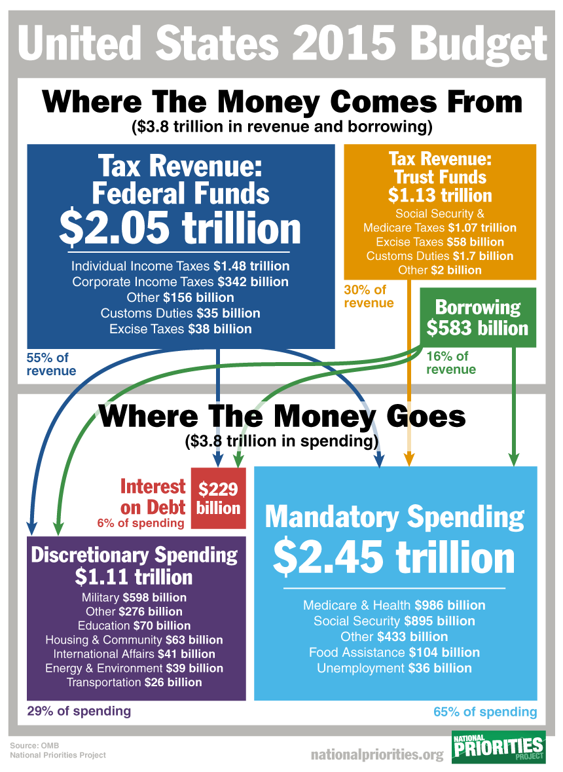
Notes:
The 2016 budget is very similar to this one.
Corporate revenue has declined to about 11 percent of all revenues from more than 40 percent in the middle of the 20th century.
Military funding and many programs come from discretionary funds: housing assistance, WIC, education funding (Title I), Head Start, Preschool for All initiative, CDBG, most jobs programs all discretionary.
Note that deficits are now back in the 2.5-3 percent range after peaking near 10 percent during the recession. That’s close to the average deficit, 2.5 percent, over the last 50 years. During those years we’ve run a deficit in all but a handful of years.

Slide 6
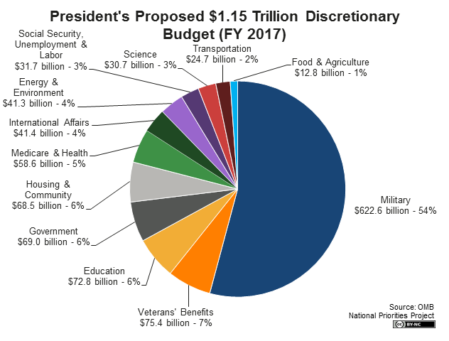
Notes:
In military we are including the baseline department of defense funding, nuclear weapons, war spending, and foreign military aid. Note that veterans’ benefits is a separate category.

Slide 7
Notes:
Note that 2017 represents the President’s proposal – if Congressional proposals go back on the December budget deal as they might, non-military spending could be even lower (and Pentagon spending could be higher).

Slide 8
Notes:
Note: these jobs include direct jobs – e.g. people employed by the military, or in education, as well as what are known as “indirect” or “induced” jobs – those generated because of the extra business in a region or community. For instance, both the military and a school will purchase some supplies from local vendors, such as electricity or toilet paper. Also, employees will spend their paycheck at local businesses like gas stations or grocery stores. All of this helps to support additional jobs in the local economy. This is what’s known as the “multiplier effect.”

Slide 9
How Congress creates budgets
It’s a two-step process (with a lot of other steps to get there).
Budget resolutions are statements of principle that outline the year’s budget.
Budget appropriations actually allocate dollar amounts to different programs.

Slide 10
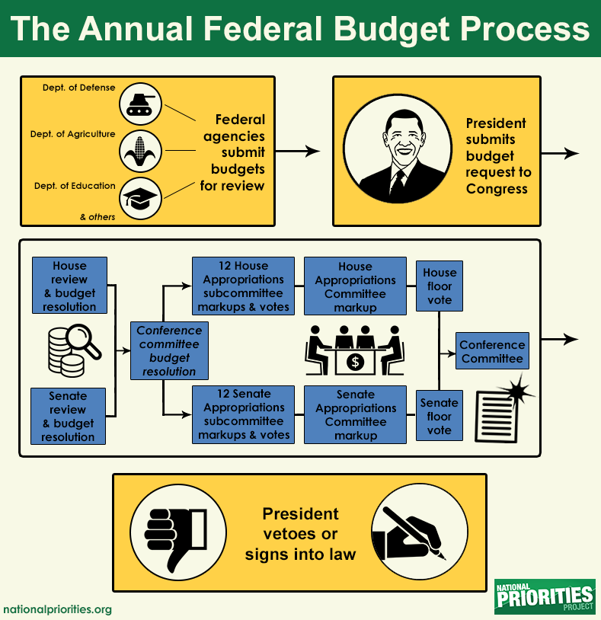
Notes:
It’s important to keep in mind that the president’s budget request is just a proposal. The budget that we end up with often looks very different. But it’s the only budget document that reflects input from all the federal agencies, who spend months each year planning what programs in their department need more funding or those that could be pared back or even eliminated.
It’s been more than 20 years since Congress actually followed this process, and in recent years we’ve seen increasing use of continuing resolutions and omnibus spending bills to fund the government after the beginning of the fiscal year until a budget agreement is reached.

Slide 11
How does federal spending get to us?

Slide 12
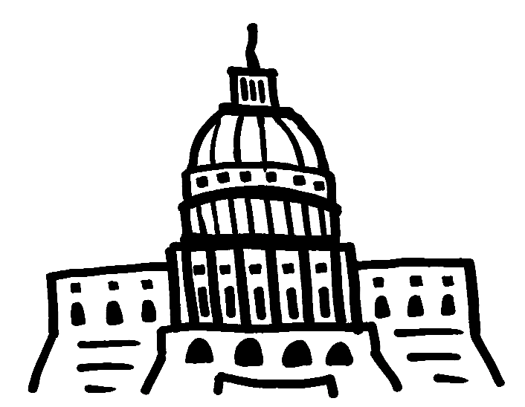
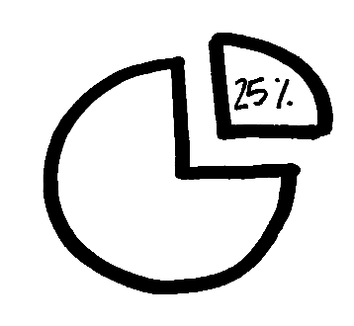
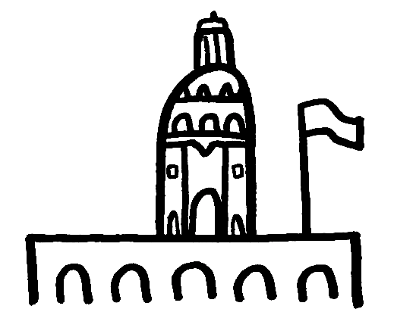
Federal Budget
State Budget
Cities & Towns
You and me
Businesses

Slide 13
Oregon State Revenue, 2015-2017

Slide 14
Federal Spending in Oregon
$8.2 billion to the state government (35% of state revenues) in 2013
$23.6 billion in federal aid to individuals (Social Security, Medicare, food stamps, unemployment, etc.) in 2014
$1.2 billion in federal contracts, 40% from the Department of Defense in 2014
$3.2 billion in compensation (wages and benefits) for federal employees in Oregon in 2014
Or about $37 billion in all.
…plus $1.1 billion direct to local governments in Oregon
Notes:
The average for all states is 30% of state revenue from federal grants.

Slide 15
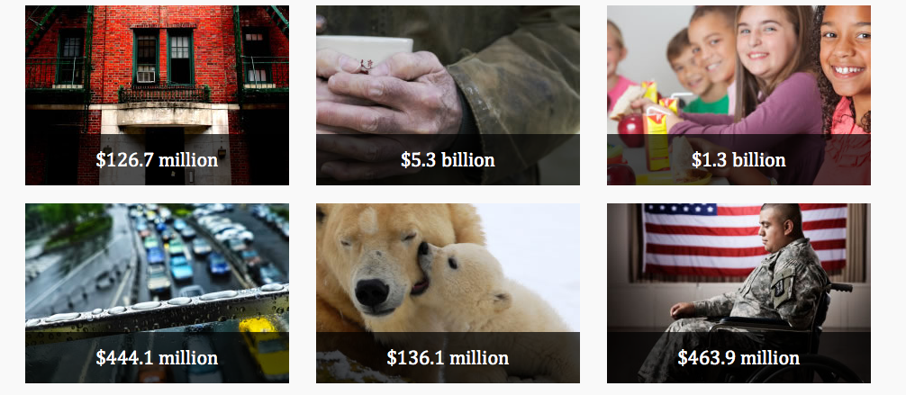
2014 Federal Grants to
Oregon: $8.2 billion
Top Row, Left to Right: Housing &Community Development, Public Assistance, Education
Bottom Row: Transportation, Natural Resources & Agriculture, Health & Hospitals
Notes:
Housing & Community Development: Section 8, Public Housing
Public Assistance: Medicaid, TANF, LIHEAP, Block Grants (does not include assistance direct to individuals)
Education: School Nutrition, Head Start, Title I
Transportation: Public Airports, Highways, Mass Transit
Natural Resources & Ag: Conservation, Flood Prevention, Fish & Wildlife
Health & Hospitals: WIC, Veterans, EPA Superfund

Slide 16
The Washington-Yourtown Pipeline
Washington, DC
Head Start, Title I
Infrastructure (water, transit, roads, bridges)
Housing assistance
Early childhood, economic development, social services block grant, food & hunger programs, weatherization, fuel assistance, youth programs
Medicare, Medicaid, TANF, SNAP, Jobs programs
Unemployment benefits, job training, jobs
Pell grants, student loans, grants to schools
Yourtown
→ Schools
→ City Hall
→ Housing Authority
→ Community/ Antipoverty
→ State Agencies
→ Employment agencies
→ Colleges

Slide 17
The People’s Budget is…
An alternative budget introduced every year by the Congressional Progressive Caucus
A grassroots People’s Budget Campaign to change national spending priorities
A possible platform for what we want to do in Oregon

Slide 18
The People’s Budget would:
Invest in infrastructure, education, and clean energy
Create 3 1/2 million good paying jobs
Protect collective bargaining, strengthen working families, and close the pay equity gap
Cut poverty in half
Reform the justice system
Rein in Pentagon spending

Slide 19
Budget timeline
Tuesday March 15: press conference unveils People’s Budget
Wednesday March 16: House Budget Committee marks up the GOP budget
House votes on budget authorization bill: March or April
House votes on budget appropriations bills: __________

Slide 20
More on the Pentagon budget

Slide 22
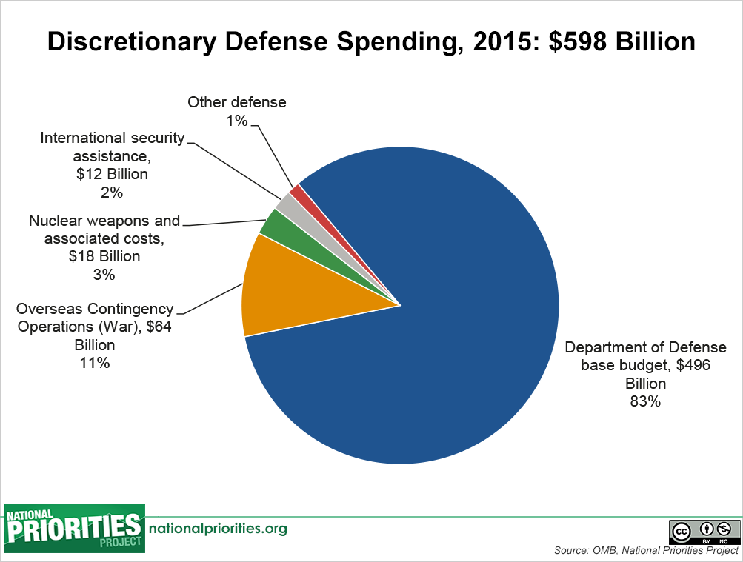
Notes:
Of the war fund (OCO), it’s estimated that $30 billion this year is actually a “slush fund” for normal Pentagon spending that didn’t fit inside the budget caps. NPP runs a “Pentagon slush fund” counter that is now at over $92 billion and counting at a rate of $3.42 million every hour.

Slide 23
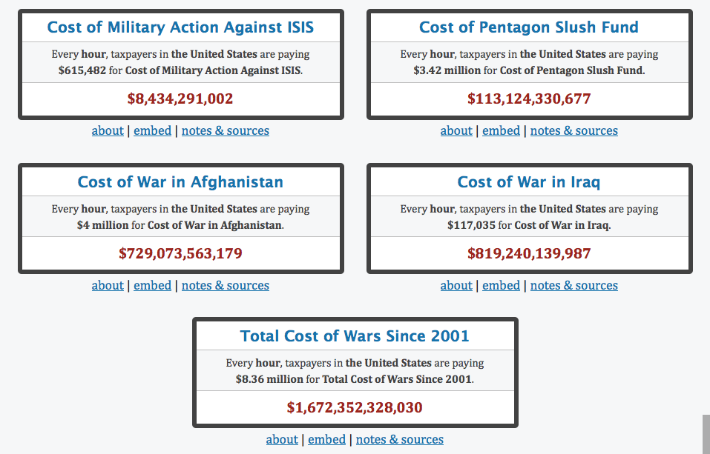
War Costs as of February 2016
Source:
nationalpriorities.org/cost-of February 25, 2016
Notes:
Visit nationalpriorities.org for up-to-the-minute (second!) counter totals. You can also click each counter to see how much your state, city, congressional district or county has paid for each of these.

Slide 24
Notes:
From 2003 to 2015, increased 115%. This reflects more spending per veteran in addition to a growing number of veterans. It also reflects to some extent the growing cost of health care.
This spending is not part of Pentagon and is not counted in earlier charts showing military spending.

Slide 25
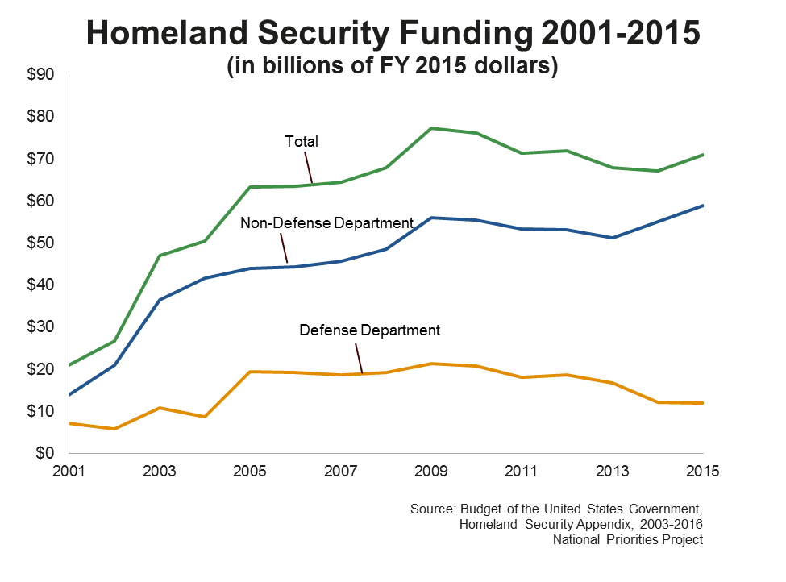
Notes:
Most Homeland Security funding, for things like border control, the TSA, etc., is also not included in military spending, although this pseudo-military spending often has the same goals.

